Slide 1
Title and Abstract
Adapted from:
  Writing Support Centre, University of Western Ontario
  and Clinical Chemistry: http://www.clinchem.org/content/56/3/357.full
  http://www.clinchem.org/content/56/4/521.full

Slide 2
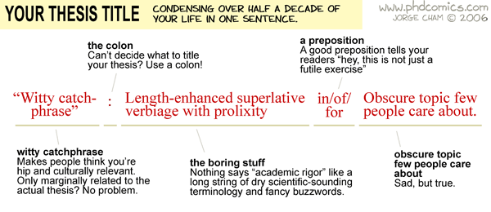

Slide 3
Title
MANY people read it
tells readers if article is useful to them
think of how others will “google” your thesis
state your contribution/approach/result in no more than 7-8 words

Slide 4
Title
start with your research aim or question:
  What is the difference between x and y?
  A comparison between x and y
  How does x affect y?
  The effect of x on y

Slide 5
Titles - Examples
Mouse Behavior (Too general)
The Effects of Estrogen on the Nose-Twitch Courtship Behavior in Mice
If possible, give the key result:
Estrogen Stimulates Intensity of Nose-Twitch Courtship Behavior in Mice

Slide 6
What’s wrong with these Titles?
H1N1 Virus Testing on Mice Using Polymerase Chain Reaction
Blood from Bone Marrow Donors Stored on Ice Yields Higher HLA-Match Percentages
Treatment of Pediatric Melanoma Patients with Lasers
Value of Amniotic Fluid Sphingomyelin Quantification in Fetuses with G1-α Gene Mutations of Unclear Significance

Slide 7
Alternative Titles
Polymerase Chain Reaction Testing of Mice for the H1N1 Virus
Increased Bone Marrow Donor HLA-Match Percentages for Blood Stored on Ice
Laser Treatment for Pediatric Melanoma
Amniotic Fluid Sphingomyelin Quantification Identifies G1-α Gene Mutations of Unclear Significance

Slide 8
Abstract
Needs to persuade readers to obtain article (not just continue reading)
Independent, self-contained
Your contribution – so that readers will remember it

Slide 9
Abstract
One or more well-developed paragraphs
Short (100-300 words; 3-5%)
Includes all the major elements of the larger text (usually in order)
No new information

Slide 10
Structure
Topic
Research Question / Problem
Methods
Results / Findings
Conclusion / Recommendations

Slide 11
Writing an Abstract
Finish your paper
Take a break
Read your paper and identify the key points for each section
Write down 1-2 sentences for each section

Slide 12
Then…
Connect ideas with appropriate transitions
Add and remove text as needed
Revise, edit, and proofread
Ask for a review

Slide 13
Mediocre Abstracts
Read like a table of contents in sentence form
Example:
The behavior of editors is discussed. What should be covered by an abstract is considered. The importance of the abstract is described. Dictionary definitions of “abstract” are quoted. At the conclusion a revised abstract is presented.
From “The Scrutiny of the Abstract” by K.K. Landes in The bulletin of the
American Association of Petroleum Geologists 35, 1951.

Slide 14
Mediocre Abstracts
Improved example:
The abstract is of utmost importance, for it is read by 10 to 500 times more people than hear the presentation or read the entire article. It should not be a mere recital of the subjects covered, replete with such expressions as “is discussed” and “is described”. It should be a condensation and concentration of the essential qualities of the paper.
From “The Scrutiny of the Abstract” by K.K. Landes in The bulletin of the
American Association of Petroleum Geologists 35, 1951.

Slide 15
Good Abstracts
Seamlessly blend the element of the associated text into one coherent paragraph
Include only relevant information (avoid the temptation to include more)
Use a clear and concise writing style

Slide 16
Good Abstracts: Topic/Purpose
Make thesis/hypothesis/objectives stand out
If possible, avoid references
Introduce specific terminology
Avoid repeating information from the title

Slide 17
Good Abstracts: Methods
Mention novel techniques
Be specific
  “20 and 40 kg/acre of nitrogen” rather than “two treatments of nitrogen”

Slide 18
Good Abstracts: Results
If many results, only present the most important
Be specific:
  “…increased by 50%” rather than “…increased”

Slide 19
Good Abstracts: Conclusions
Just major implications
Relate back to your purpose and research question

Slide 20
Abstract types
for a journal article
  readership of journal
for a conference presentation
  reviewers
for a grant proposal
  “gatekeepers”
for a dissertation
  committee *

Slide 21
Conference Abstracts
Two purposes:
“Should I attend this talk?”
“What was that great talk about?”

Slide 22
Conference Abstracts
Usually written before the results are in or the paper is finished (work in-progress)
Write as though you are done (you might be done by the time the conference arrives)
Less formal than journal abstracts (but adhere to the conventions of professional communication)

Slide 23
When & How
journal, grant, dissertation – written last
conference – before completion

Slide 24
Two models:
  summarizes all subsections of research article
    some journals give subtitles to the different parts
  focuses on one or two aspects of study – usually method and results

Slide 25
model
1 | Background Aim/Purpose What the paper does
2 | Methodology / Materials
3 | Key Result/Finding Achievement / Contribution
4 | Applications
5 | Implications for the field, real life Future work

Slide 26
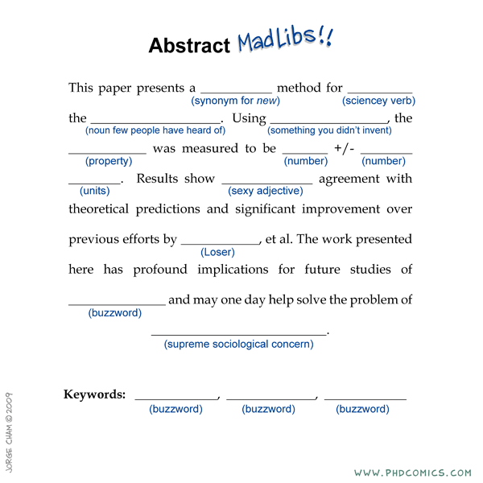

Slide 27
Characteristics of a
Well Written Abstract
Stands on its own without need to read the paper
States the hypothesis, question, or objective of the study
Completes the story by answering the hypothesis, question, or objective
Contains the same key words and terms as the title and the introduction
Follows the correct style and format
Follows the order of the main text (e.g., IMRAD)
Stays within the allowed word count
Does not contain information absent in the paper
Does not make conclusions unsupported by the data
Limits the use of abbreviations
Does not include references
Does not cite tables or figures

Slide 28
Abstract Checklist
Any scientist reading it should be able to understand:
  why the work was carried out
  why it is important (context and need)
  what the authors did (method, task)
  what the paper reports about this work (objective/purpose of the document)
  what the authors found (key findings)
  what these findings mean (the conclusion)
  possibly what the next steps are (perspectives)

